Slide 1
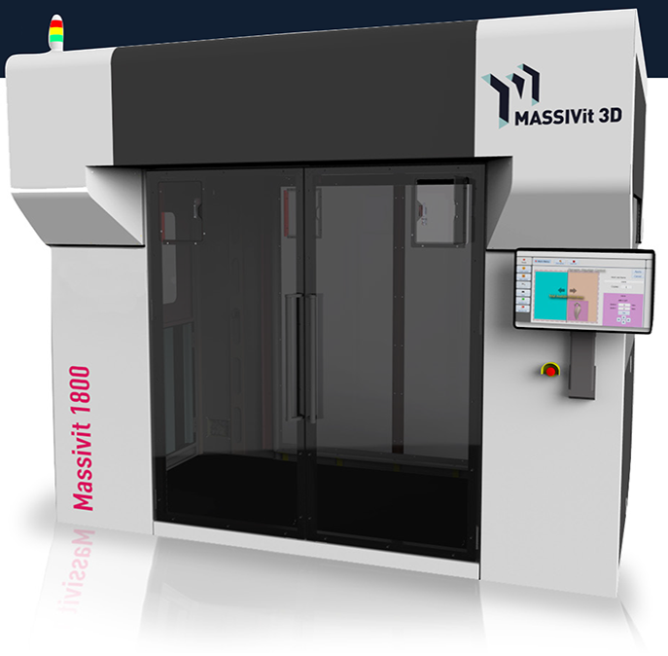
Massivit 3D
2017
Company Confidential

Slide 2
22
Thank you all !!!

Slide 3
2016 Main Achievements
Sale 22 printers
Effectively start selling at Drupa June 2016
Building sales distribution network of 23 dealers
Today Massivit has more than 100 sales people WW promoting our product

Slide 4
Sales by Region
Region | Quantities
EMEA | 14
Asia Pacific | 5
USA | 2
LATAM | 1
Total | 22

Slide 5
Sales by Quarter
Quarter | Quantities
Q1 | 3
Q2 | 12
Q3 | 2
Q4 | 5
Total | 22

Slide 6
Sales by Country
Country | Quantities
UK | 4
Australia | 3
USA | 2
Russia | 2
France | 2
Israel | 2
Turkey | 2
Sweden | 1
Mexico | 1
Italy | 1
Hong Kong | 1
Japan | 1
UK Leading wit 4 printers

Slide 7
Next step – conference call
We will have a conference call with the sales team on the 2nd week of Jan
Each sales person need to prepare:
Win /Loss analysis
What do we need in order to meet the 2017 goals
Your needs
Your wish list

Slide 8
Thank You

